Slide 1
Object Oriented Programming using Unity/C#
Erik Kesa

Slide 2
What will we be learning this semester?
Unity and C# - A rapid prototyping tool/Game engine and a beautifully designed Object Oriented Programming language.
Basics of software architecture with focus on game design - why is it useful and what are the benefits?
SOLID programming principles.
Object Oriented Programming principles.
Programming patterns useful in game development and game AI.

Slide 3
How will we be working?
Good software architecture starts way before writing the first lines of code - we will be learning to express our game design through activity diagrams and structure our data through class diagrams using Draw.io - https://app.diagrams.net/
We will be implementing our logic based on those diagrams, and trying to adher to the principles of SOLID programming.
we will cover theory and pracice side-by-side

Slide 4
What will we be making?
A Space Invaders clone to revisit core unity concepts and the C# programming language. (Mostly from scratch)
A Heroes of Might and Magic clone to explore concepts of Object Oriented Programming such as interfaces and polymorphism (we will only be focusing on hex-based battle scene).
A Stealth Game to have a look at some interesting Game AI patterns (Command, Singleton) (If we get there)

Slide 5
Final assignment
You will be tasked with extending the gameplay of our Heroes-like game prototype with: a) new enemy types (3)
b) new attack types for enemies (3)
c) new actions besides guard, move, attack (1)
d) One player special mechanic, that can be used once per round

Slide 6
Unity refresher
Uses C# as the scripting language
Is a complete game engine and so much more.
Can be used for 2D and 3D
Can ship games to virtually anything - PC, Android, iOS, Washing machines
Uses the Game Loop, Component and GameObject patterns under the hood.

Slide 7
C# refresher
Compiled language
Managed Code
Strongly typed
Function based
Object oriented

Slide 8
C# refresher – Basic types
bool
int
float
string
char

Slide 9
C# refresher – Control statements
If
While
For
Foreach

Slide 10
Core principles of object oriented design
Object oriented programming is a way of thinking about programming. It is a very common methodology in games and other commercial applications. In OOP, you define classes and relationships between them and rules for interaction between objects. Think of Classes as blueprints for objects - Eg if you would have a player class, its data members would be lives, and member functions would be anything a player can do. Classes are similar to C Structs, with the exception, that classes can also define behavior.

Slide 11
Activity diagrams and class diagrams
The two main types of diagrams we will be making are activity diagrams and class diagrams.
An activity diagram is used to describe a process from start to end - examples are diagrams of the core game loop.
A class diagram serves to map out the most important classes and their relationships.

Slide 12
Space Attackers
A space invaders like game where waves of monsters are spawned from the top at a set time interval .
The player controls a space ship that can move left or right
Clicking the space button fires a laser.
Each monster that hits the player, damages them
Each monster that reaches the ground, damages the player
When the player is out of lives, the game ends
https://drive.google.com/drive/folders/1Wp4JdjgH2BgqOzRe3UyC6PaI2Y8GksWG?usp=sharing

Slide 13
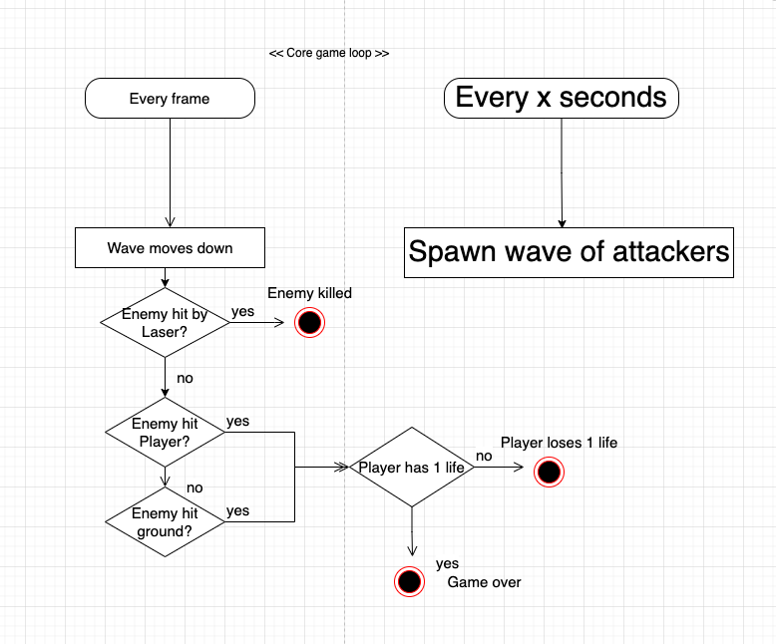
Core game loop activity diagrams

Slide 14
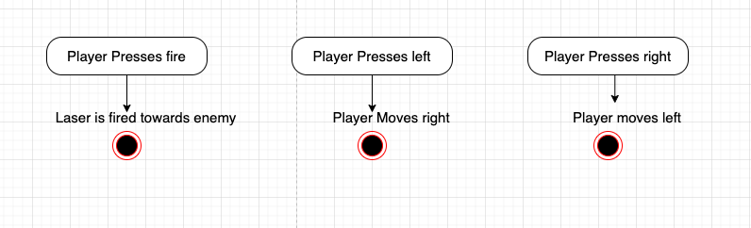
Core game loop activity diagrams

Slide 15
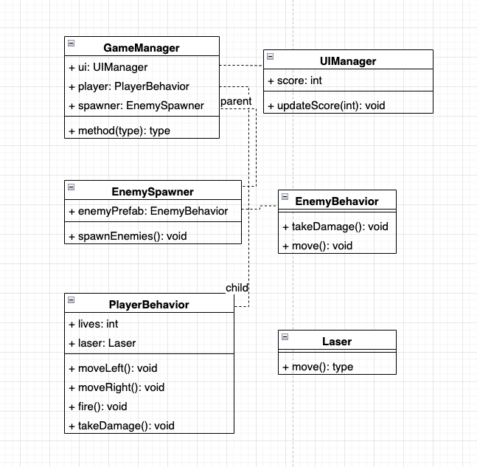
Data structure and class diagrams

Slide 16
Implementing the player

Slide 17
Implementing the wave spawner

Slide 18
Implementing the enemies

